Slide 1
3 Axis Pin Development Update
Week #2

Slide 2
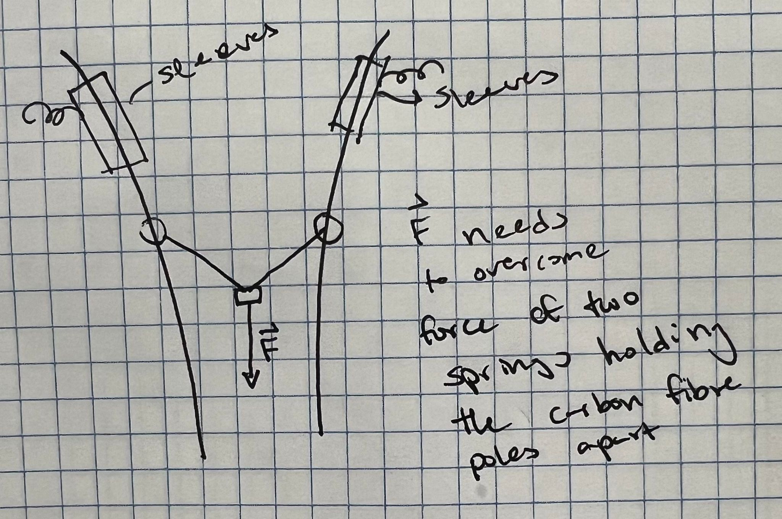
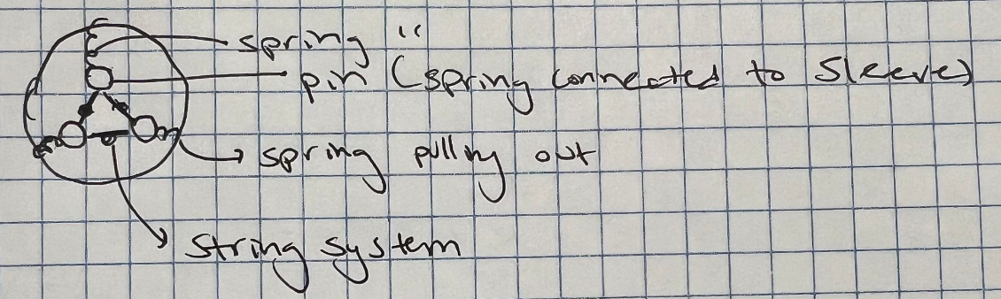
Idea

Slide 3
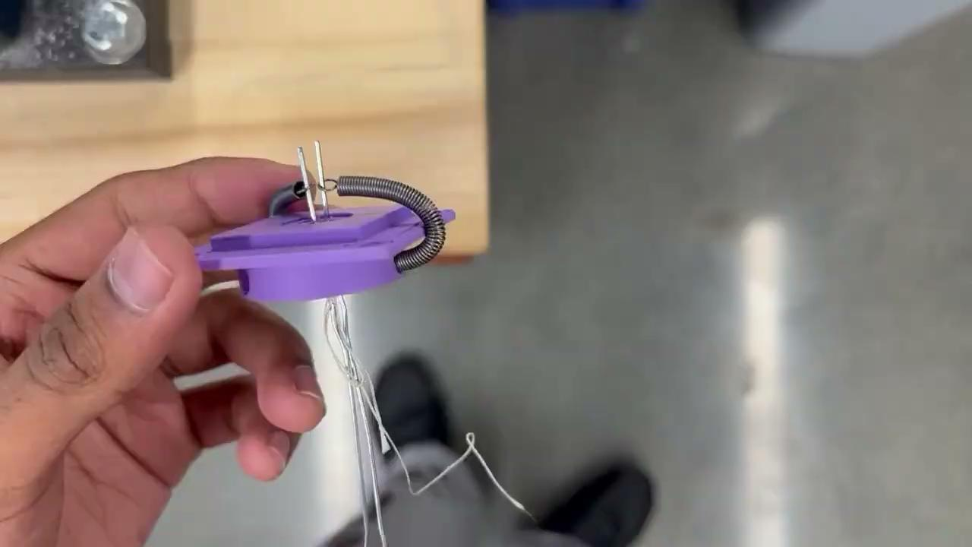
So far…

Slide 4
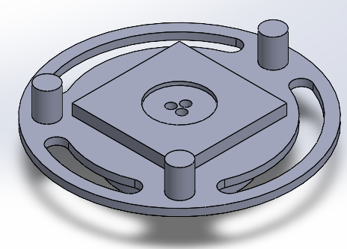
Problems
Need ‘wider coupling’ for horizontal translation
Too many degrees of freedom (want to restrict to 3)
1 vertical, 2 rotation

Slide 5
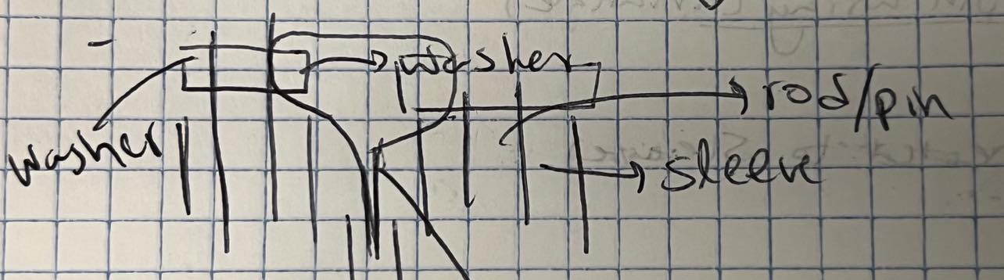
Solution
Connect spring to sleeve above mount

Slide 6
Prototype V2

Slide 7
Current Plans
Find small springs / cuts springs (modifying k)
Test Washer Idea
Develop base for testing

